Slide 1
Artificial intelligence / machine learning applications from a central bank perspective
José Manuel Marqués
Head of the Financial Innovation Division
48th World Continuous Auditing and Reporting Symposium
Madrid
24 September 2020
Dg operations, markets and payment systems
ADG FINANCIAL INNOVATION AND MARKET INFRASTRUCTURES

Slide 2
AGENDA
General overview
AI/ML projects at Banco de España
Other technologies: DLT projects at Banco de España
Appendix
Adg financial innovation and Market infrastructures

Slide 3
AI&ml applications from a cb perspective
General overview
Text Mining and NLP projects
Data Quality and anomaly detection projects
Projects in the Banknotes area
Areas of particular regulatory interest
Extensive work on AI/ML tools
+ analysis of other emergent technologies: DLT
Adg financial innovation and Market infrastructures

Slide 4
AI&ml applications from a cb perspective
Text Mining and NLP projects
New economic policy uncertainty index for Spain (EPU).
Extraction of structured data from mortgage loan agreements.
Semi-Automated review of certain aspects in consumer credit.
Extraction of Climate-related disclosures from financial reports.
Sentiment analysis of Bank of Spain’s Quarterly reports.
Sentiment analysis of Financial Stability Reports.
Text mining of press bulletin to aid weekly economic situation report.
Topic modelling of Statements and press conferences of Central Banks.
Adg financial innovation and Market infrastructures

Slide 5
AI&ml applications from a cb perspective
Data Quality and anomaly detection projects
Detecting faults & outliers in CBSO questionnaires.
Detect alternative patterns to assess data quality and perform data imputation of missing values via machine learning for questionnaires sent by corporations to the Central Balance Sheet Data Office.
Data Analytics on Basel III reports to improve data quality.
Detect anomalies, quality problems and inconsistencies not covered by the XBRL validations in the COREP and FINREP reports.
Adg financial innovation and Market infrastructures

Slide 6
AI&ml applications from a cb perspective
Projects in the Banknotes area
The BIAS-FD Tool.
Tool to calculate the quality of a banknote to determine whether it is usable (FIT-UNFIT) using supervised Machine Learning algorithms.
Big data applied to banknotes.
Extraction of information of banknotes (S/N + 12 properties) using a banknote processing machine (G&D BPS M7).
Neurometrics applied to the design of banknotes and their security features.
Methodology based on biometric response of people that uses advanced machine learning algorithms for neurometrics generation.
Adg financial innovation and Market infrastructures

Slide 7
AI&ml applications from a cb perspective
Areas of particular regulatory interest
Use of machine learning in A) Credit risk & B) Application of text mining to the analysis of climate-related disclosures.
Analysis aimed at improving overall understanding of novel tools focusing on one of their most likely fields of applications.
Approaching a measurement of potential enhancements in regulatory compliance by market participants.
Identifying emerging risks (latency, interpretability, etc.) and mechanisms to address them.
Building up internal knowledge and capabilities to help evolve the way a central bank meets its duties.
Adg financial innovation and Market infrastructures

Slide 8
AI&ml applications from a cb perspective
DLT projects
Pilot DLT project applied to payments.
Platform that implements an account-based CBDC, based on the hypothesis that the central bank as issuer would rely on commercial banks for the distribution of money to the users. Based on IBM Hyperledger Fabric.
Pilot DLT project applied to clearing and settlement of securities / CBDC.
The pilot simulated a real-time, multi-currency, gross securities settlement platform together with User Interface using Corda.
Exploring self sovereign identity solutions.
In partnership with private actors, trying out flexible and portable systems to secure privacy of users in their transactions and interactions.
Leverage industry and public credentials and provide self-management of data while addressing several accreditation needs.
Relies on a trusted identity server (app or browser accessible), a portable identity wallet (id container), obfuscation via cryptography (DDIs) and use of digital certificates.
Adg financial innovation and Market infrastructures

Slide 9
THANK YOU
Adg financial innovation and Market infrastructures

Slide 10
Appendix
Adg financial innovation and Market infrastructures

Slide 11
AI&ml applications from a cb perspective
Published research papers
“Financial Frictions and the Wealth Distribution”. Fernández-Villaverde, J.; Hurtado, S.; Nuño, G. (2019).
“The effects of tax changes on economic activity: a narrative approach to frequent anticipations”. García-Uribe, S. (2018).
“The Catalonian Crises through Google Searches: A Regional Perspective”. Artola, C.; Pérez, J.J. (2018).
“Nowcasting private consumption: traditional indicators, uncertainty measures, and the role of internet search query data”. Pérez, J.J.; Urtasun, A. (2017).
“Las huellas del futuro están en la web: construcción de indicadores adelantados a partir de búsquedas en internet”. Artola, C.; Galán, E. (2012).
“A genetic algorithm estimation of the term structure of interest rates”. Gimeno, R.; Nave, J.M. (2006).
Adg financial innovation and Market infrastructures

Slide 12
AI&ml applications from a cb perspective
Use of ML in credit risk
Analysis of the use of ML in credit risk. Alonso, A.; Carbó, J.M. (papers pending publication and ongoing work).
Practical framework to measure the dilemma benefit-supervisory cost
Measuring i) the benefit as the classification power of different ML models using a public database, and ii) the supervisory cost function according to the model uses through a suggested scorecard.
Project #1
Measuring benefits
Empirical excercise to assess the predictive performance of 6 ML models using an actual database from a Spanish bank.
Assessment of the economical impact of using ML by measuring the savings in capital requirements under the IRB foundational approach.
Project #2
Measuring the supervisory cost
Measuring algorithmic complexity.
Interpretability of predictive models.
Technology consumption and biases.
Future projects
ADG FINANCIAL INNOVATION AND MARKET INFRASTURCTURES
Notes:
Además de cuestiones de naturaleza metodológica (p.ej: evitar comportamientos pro-cíclicos), en EBA (2020) se mencionan también cuestiones operativas que dificultan el uso de ML:
Riesgo tecnológico: integración del legado tecnológico, dependencia de proveedores externos de computación en la nube y almacenamiento de datos, así como ciber-seguridad.
Calidad de los datos: privacidad, (des)confianza en datos no estructurados.

Slide 13
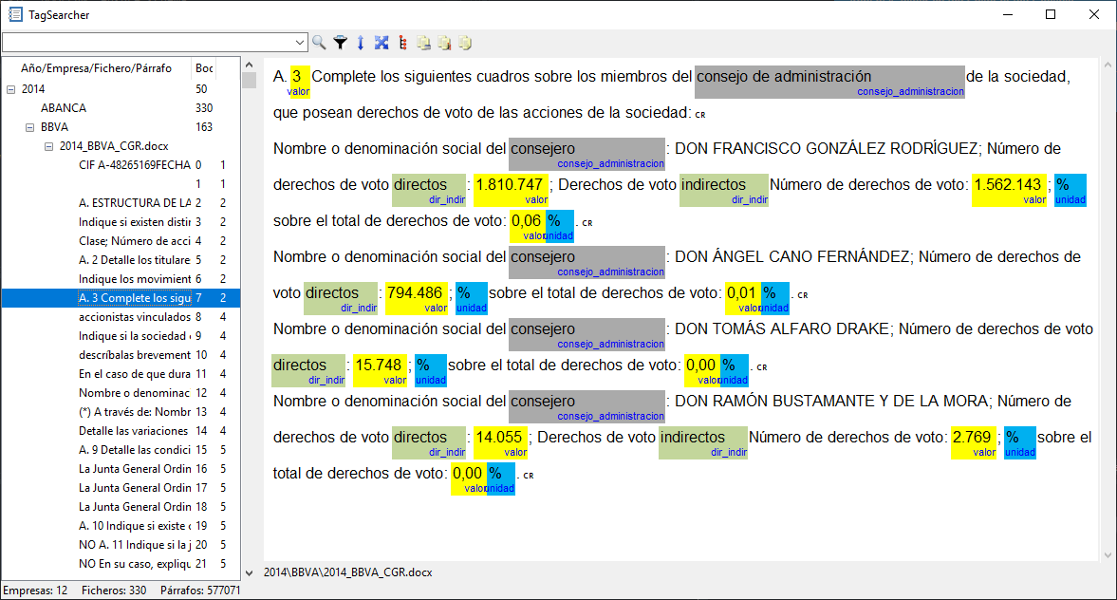
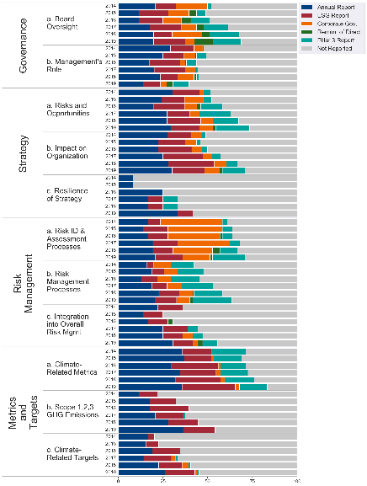
AI&ml applications from a cb perspective
Creation of a TCFD compliance index using an NLP approach
Application of text mining to the analysis of climate-related disclosures. Moreno, A.; Caminero, T. (pending publication).
Rule-based Named Entity Recognition (NER) model allows identifying and tagging climate-related concepts.
Search tool and engine are used to find combinations of the identified concepts within the reports.
A set of queries designed to locate specific disclosures through the search engine is used to build a TCFD compliance index.
The 12 Spanish significant banks were analysed. Results from 2014-2019 show progress is being made but some areas are lagging.
ADG FINANCIAL INNOVATION AND MARKET INFRASTURCTURES
Notes:
Área: División Innovación Financiera en colaboración con Central de Balances
Personas de contacto: José Manuel Marqués, Teresa Caminero y Ángel Iván Moreno
Se usa Kofax Advanced PDF Extractor para el OCR de los informes.
Las tablas se pre-procesan para adaptarlas a un formato adecuado para el procesado
En Python se usa spaCy para el modelo basado en reglas
La herramienta de búsqueda de etiquetas está desarrollada internamente en Python

